Slide 1
ASP.NET Performance Tips and Tricks
Kevin Griffin
kevin@kevgriffin.com
twitter.com/1kevgriff

Slide 2

About Me
Kevin Griffin Independent Consultant Microsoft MVP, ASP.NET
kevin@kevgriffin.com
http://kevgriffin.com
@1kevgriff

Slide 3


Simple Windows Server Monitoring
14-day Free Trial
http://winsitter.com

Slide 4

http://wintellectnow.com
Promo Code: GRIFFIN-13

Slide 5

http://aspnetaccelerator.com

Slide 6
Defining Performance

Slide 7
Performance is the amount of time a person will wait before getting pissed off.

Slide 8
Performance is sweating because you have ONLY 8 cores and 32 gigs of RAM.

Slide 9
Done before you ask
Throw Computer Out the Window
The Great Scale of Performance

Slide 10

Done before you ask
Throw Computer Out the Window
The Great Scale of Performance
Google
ASP.NET Application After File, New
Visual Studio

Slide 11
Why Performance?

Slide 12
3 Numbers to Remember

Slide 13
100 milliseconds

Slide 14
1 second

Slide 15
10 seconds

Slide 16
Did you know: Google will rank a slower loading website below a faster one.

Slide 17
The number of mobile device users is growing by the daily.
They hate slow websites.

Slide 18
Two simple rules for better performance

Slide 19
Fewer
payloads

Slide 20
Faster
payloads

Slide 21
20 ASP.NET Performance Tips
(And you’re not going to believe #5)

Slide 22
#1

Slide 23
Disable “debug” mode

Slide 24


Slide 25


Slide 26
#2

Slide 27
Enable HTTP Compression

Slide 28
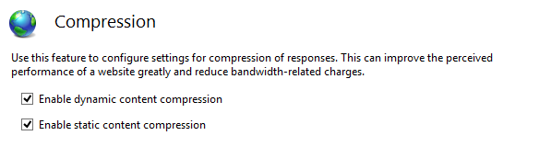

Slide 29
What gets compressed?
HTML
JavaScript
JSON
CSS
XML
Non-compressed images (ico)

Slide 30
#3

Slide 31
Enable IIS Auto-Start

Slide 32
Do you have a lot of upfront loading and configuration?

Slide 33
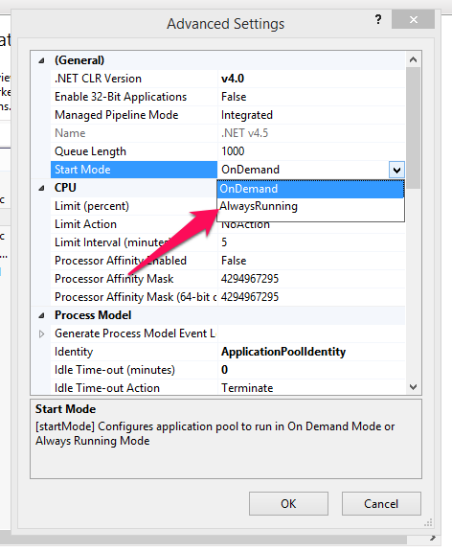

Slide 34
#4

Slide 35
Disable ViewState

Slide 36
Ways to Disable
Control
Add EnableViewState=“false” to control
Page
Add EnableViewState=“false” to the <%@ Page %> construct
Application
<configuration>
<system.web>
<pages enableViewState="false" />
</system.web>
</configuration>
Machine
<Machine.config >
<system.web>
<pages enableViewState="true" />
</system.web>
</Machine.config>

Slide 37
#5

Slide 38
STOP using WebForms

Slide 39
I’m just kidding.

Slide 40
But seriously, stop it.

Slide 41
#6

Slide 42
Disable SessionState

Slide 43
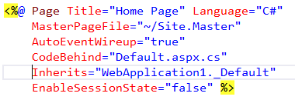

Ways to Disable
Application
Page

Slide 44
#7

Slide 45
Throw hardware at it!

Slide 46

Stop it!

Slide 47
Processors are cheap.
RAM is cheap.

Slide 48


Slide 49
#8

Slide 50
Minify/Compress JavaScript and CSS

Slide 51
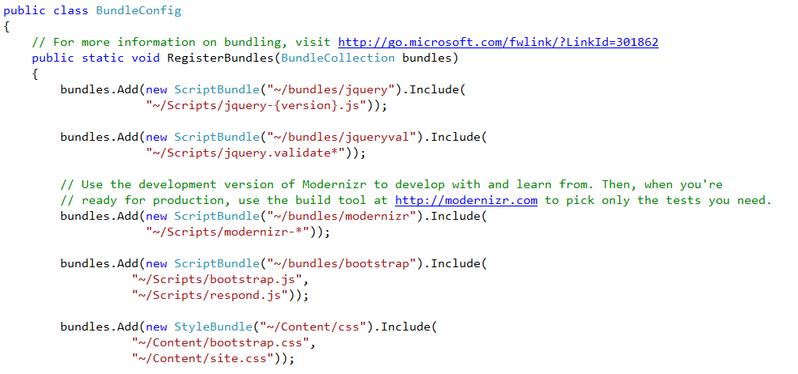

Slide 52


Slide 53


Slide 54
#9

Slide 55
Output Cache

Slide 56
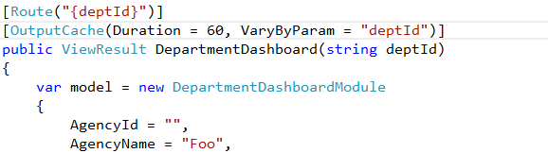

Slide 57
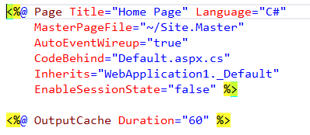

Slide 58
Caching Options
Duration (in seconds)
Location
Client
Server
Proxies
VaryByParam
VaryByHeader
SqlDependency

Slide 59
#9b

Slide 60
Cache “look up”
tables

Slide 61
#10

Slide 62
Review Resources Requested

Slide 63
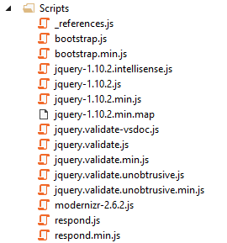

Slide 64
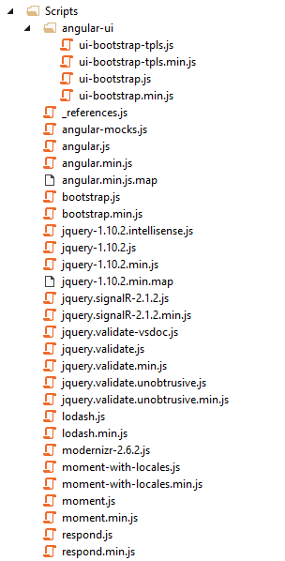

Slide 65
#11

Slide 66
Async

Slide 67
.NET Async Features
Speeds up parallel processes
Useful if your page needs to talk to several data sources

Slide 68
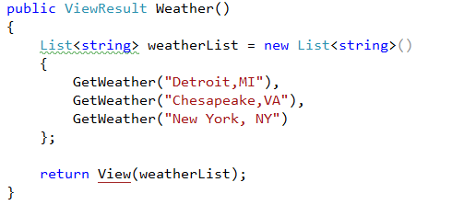

Slide 69
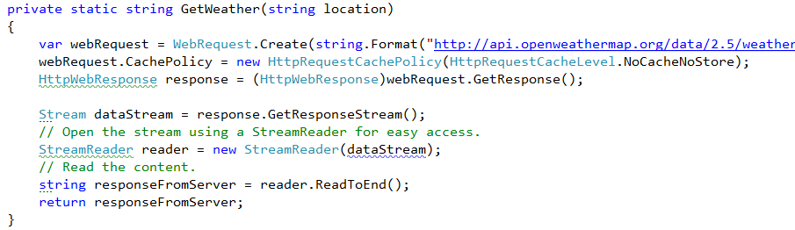

Slide 70
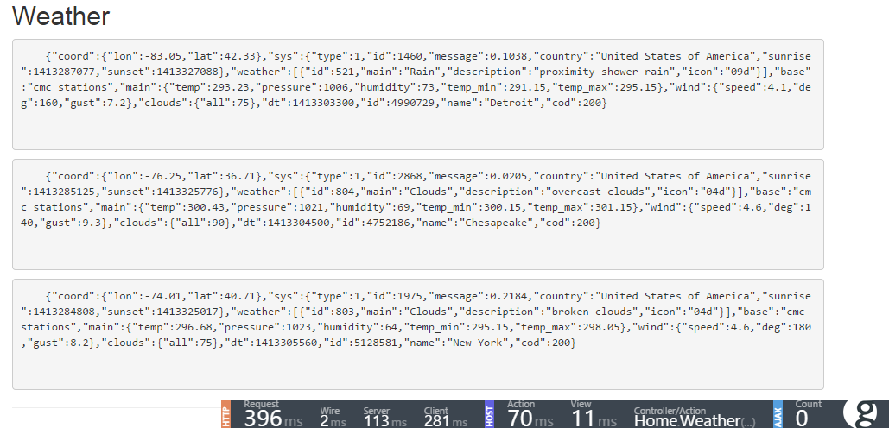

Slide 71
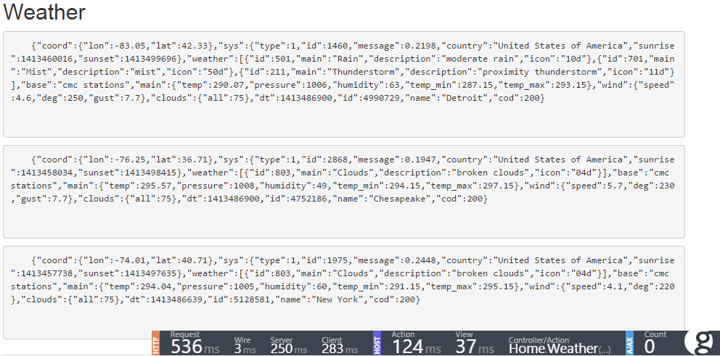

Slide 72
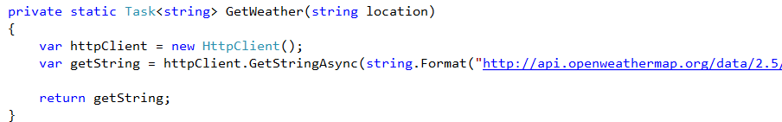

Slide 73
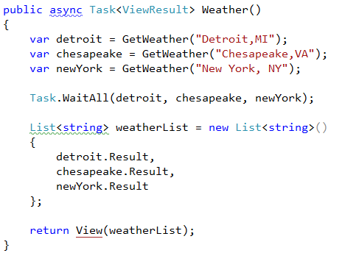

Slide 74
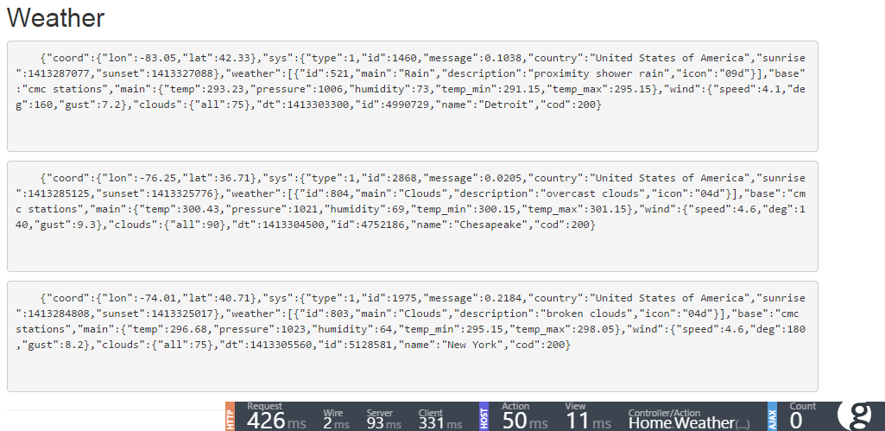

Slide 75
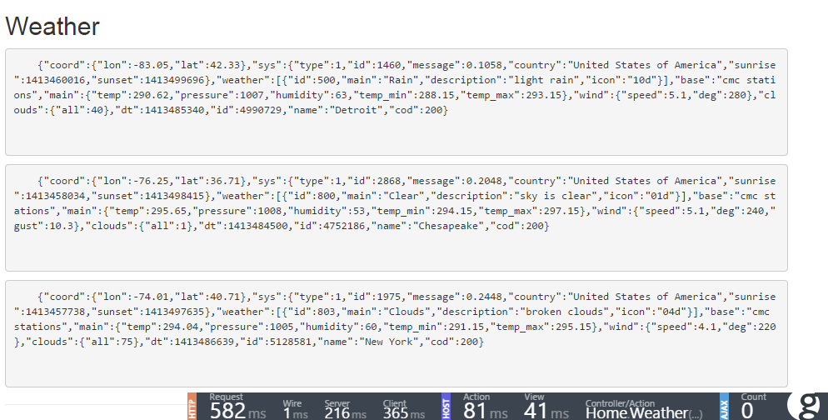

Slide 76
#12

Slide 77
CDNs and
Subdomains

Slide 78
CDNs and Subdomain
Modern browsers limit downloads from a single domain.
http://assets.kevgriffin.com/images/2014/foo.png
could be better as
http://a1.assets.kevgriffin.com/images/2014/foo.png

Slide 79
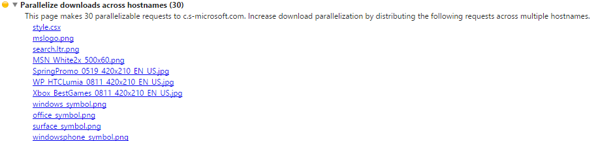

Slide 80
#13

Slide 81
Glimpse

Slide 82
http://getglimpse.com

Slide 83
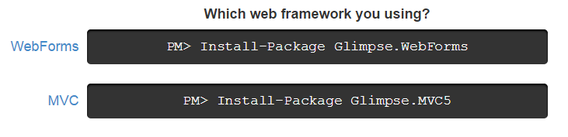

Slide 84
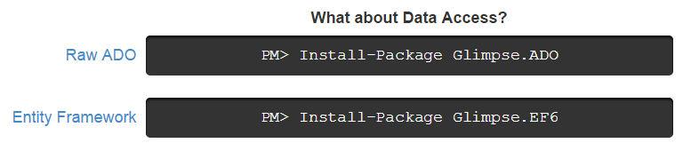

Slide 86
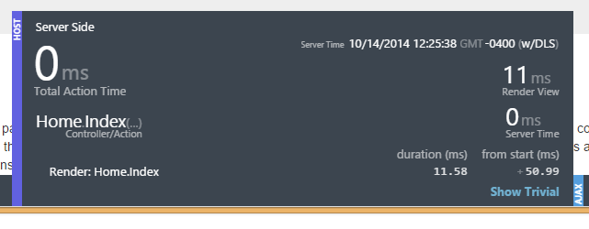

Slide 87
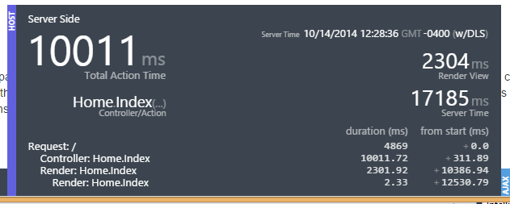

Slide 88
#13b

Slide 89
Measuring
Performance

Slide 90
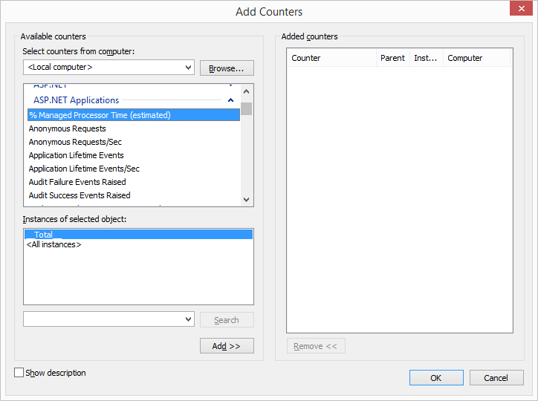

Slide 91
Two types of counters:

Slide 92
Server Counters
Application Restarts
Applications Running
Request Execution Time
Request Wait Time
Requests Queued
…

Slide 93
ASP.NET Application Counters
Requests per Second
Managed Processor Time
Managed Memory Used
Cache Hits/Misses
Requests Not Found/Authorized/Rejected
Requests Succeeded
...

Slide 94
Perfmon.exe
(Just type it into the Start menu)

Slide 95
#14

Slide 96
Upgrade Your User Experience

Slide 97


Slide 98


Slide 99
#15

Slide 100
ORM
Considerations

Slide 101
Test code-generated “read” vs Stored Procedures

Slide 102
Optimize for Ad Hoc Queries

Slide 103
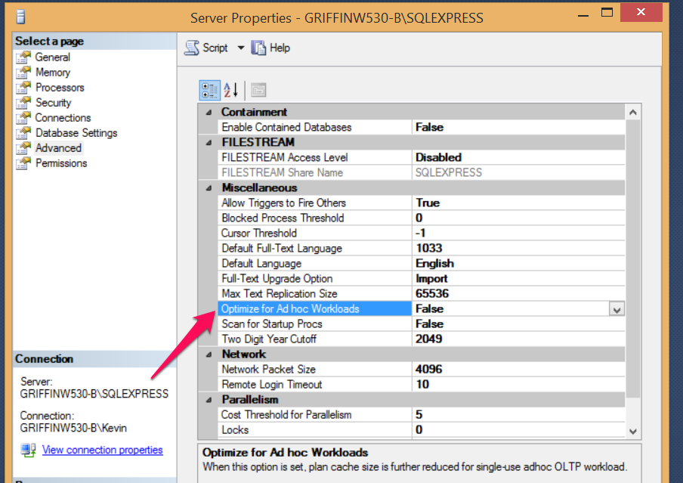

Slide 104
#16

Slide 105
Dispose SQL Connections Appropriately

Slide 106
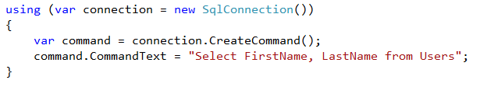

Slide 107
#17

Slide 108
Hire a DBA to Optimize Database Indexes and Stored Procedures

Slide 109
Or if you must “do it yourself”
Create indexes for columns used inside of:
WHERE clauses
JOIN clauses
ORDER BY clauses
GROUP clauses
TOP clauses

Slide 110
Or if you must “do it yourself”
Don’t do SELECT *

Slide 111
#18

Slide 112
Consider Alternative Data Stores

Slide 113
Alternatives
MongoDB
RavenDB
Redis
Azure Tables

Slide 114
#19

Slide 115
Embrace Workflow

Slide 116
Workflow
Message-based workflows
Examples: RabbitMQ, ZeroMQ, Azure Queues, etc
Offload long running and critical tasking
Example: Twitter, Amazon

Slide 117
#20

Slide 118
Hire Me

Slide 119
Stay Classy
Kevin Griffin Independent Consultant Microsoft MVP, ASP.NET
kevin@kevgriffin.com
@1kevgriff

